Slide 1
Magnus Effect on a Cylindrical Airfoils
Zhangxi ‘Jesse’ Feng, Simon Popecki, James Skinner
Advisor - Samuel Cole
May 5th, 2017

Slide 2

Purpose of Experiment
Evaluate the effect of cylinder radius on the lift force
Evaluate the effect of wind speed on the lift force
Evaluate the effect of airfoil RPM on the lift force

Slide 3
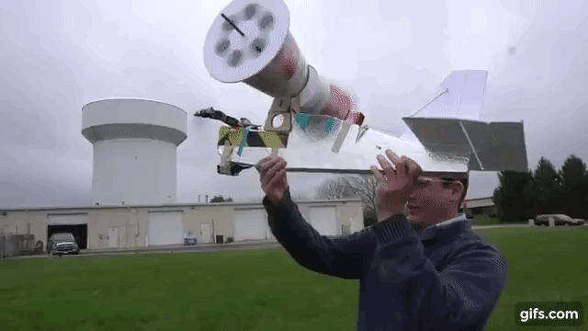
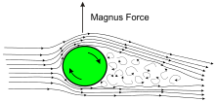
Background
The Magnus effect is observed from spinning objects curving away from the usual trajectory.
This experiment follows the Kutta-Joukowski lift force where the spinning cylinder creates a pressure difference by “pushing” the air down, and the air pushes back up.

Slide 4
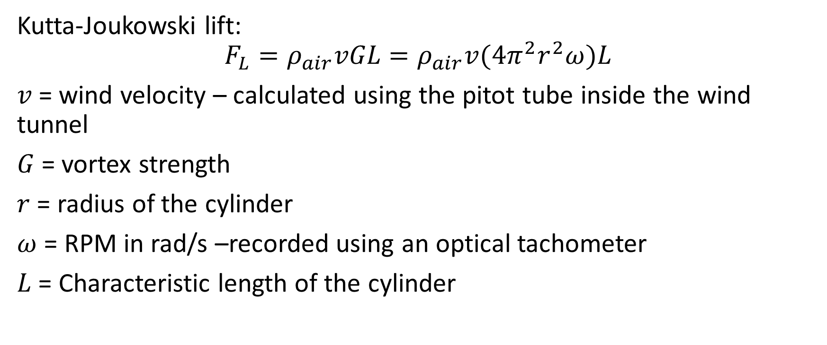
Governing Equation
Kutta-Joukowski lift:
$$F_{L}=ρ_{air}vGL=ρ_{air}v(4π^{2}r^{2}ω)L$$
$v$= wind velocity – calculated using the pitot tube inside the wind tunnel
$G$= vortex strength
$r$ = radius of the cylinder
$ω$ = RPM in rad/s –recorded using an optical tachometer
$L$ = Characteristic length of the cylinder

Slide 5
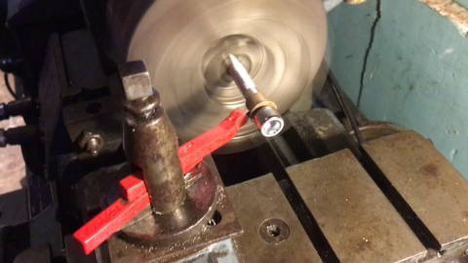
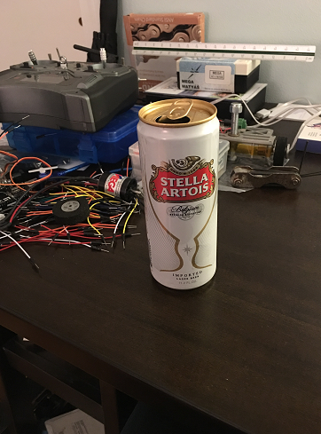

Preparation
Checking the validity of the bronze bearing
Preparing the cylinders
Welding the mounting bracket

Slide 6
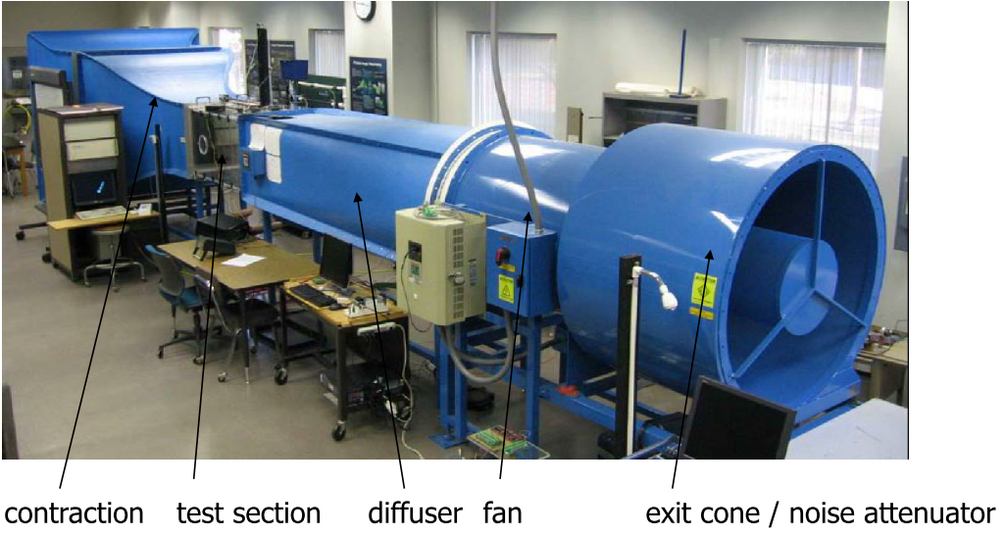
Experiment Environment

Slide 7

Equipment Used
Motor - Mega Motor ACn 16/15/8
Electronic Speed Controller (ESC) – Thunderbird 18
Transmitter – Spektrum dx6i
Receiver – Spektrum Bot BR6000
Handheld Optical tachometer
Calipers
Cylinders from Stella, Budweiser, and Quaker Oats

Slide 8
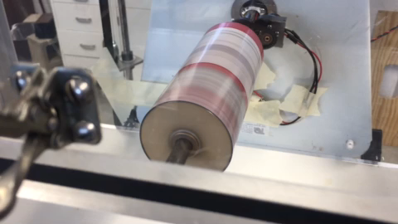
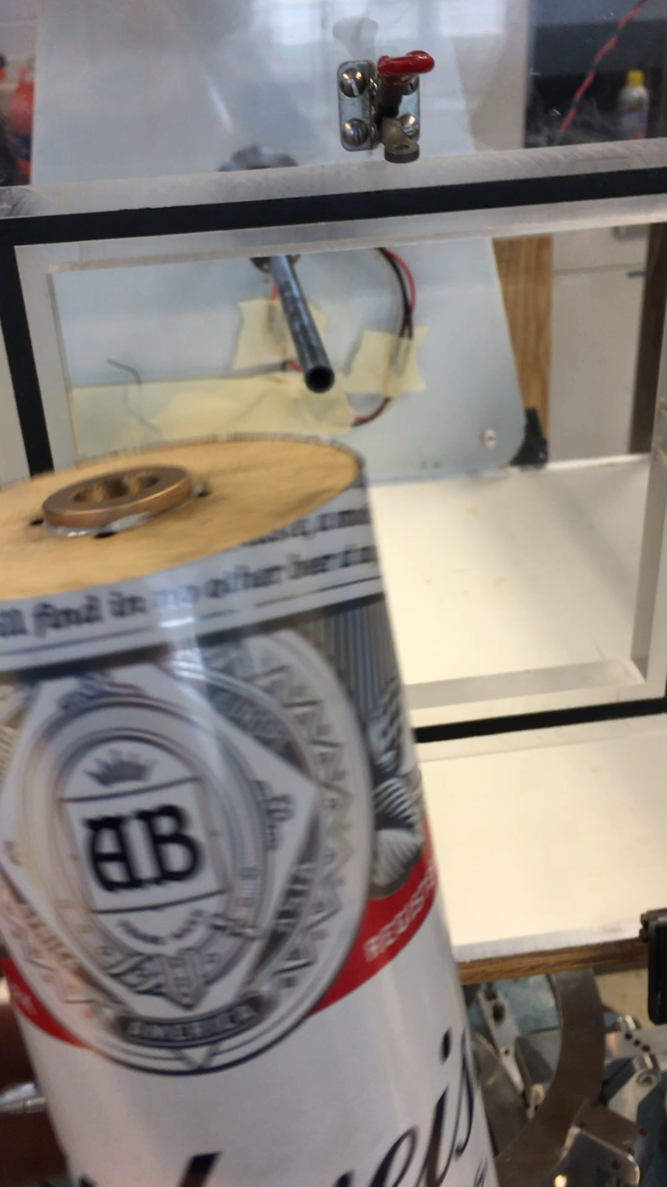
Cylinder Experimental Setup

Slide 9
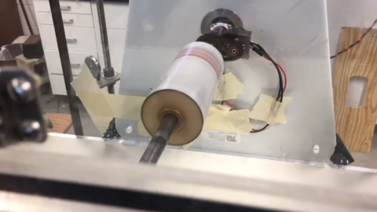
Experiment Procedure

Slide 10
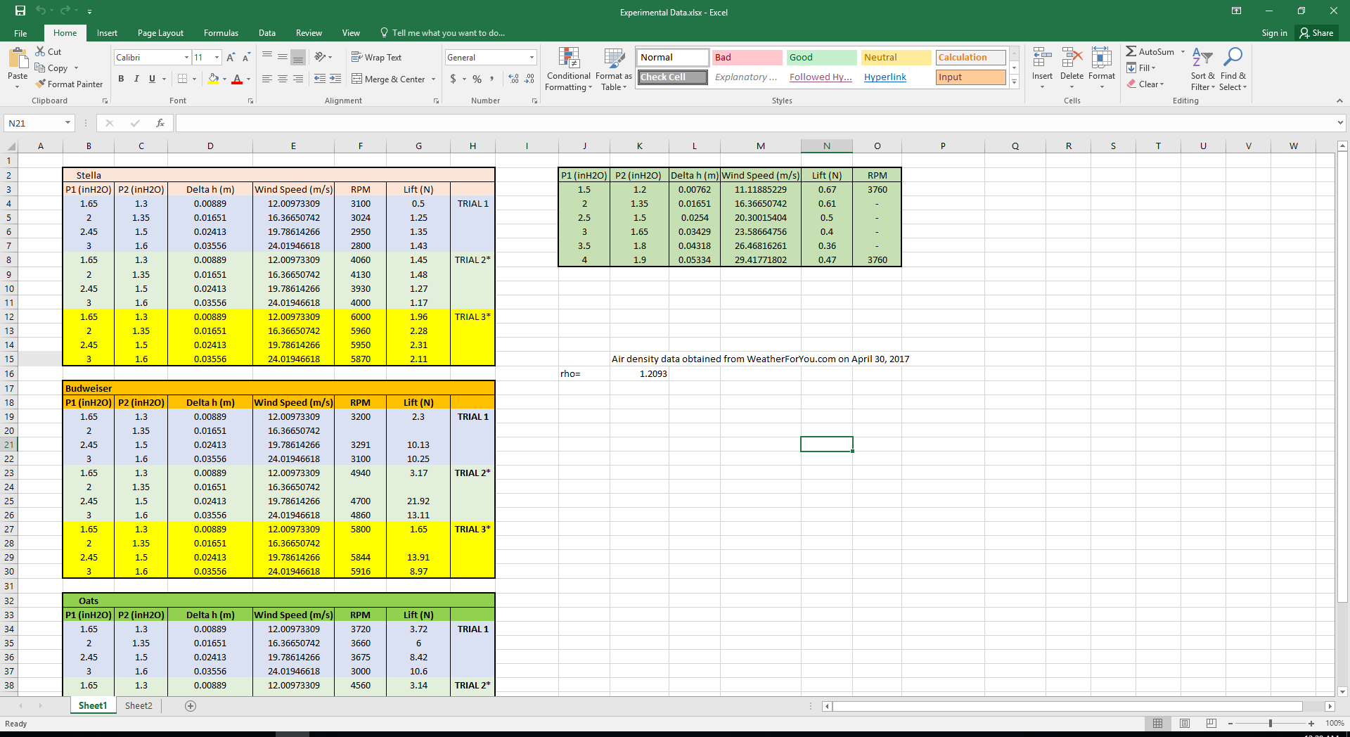

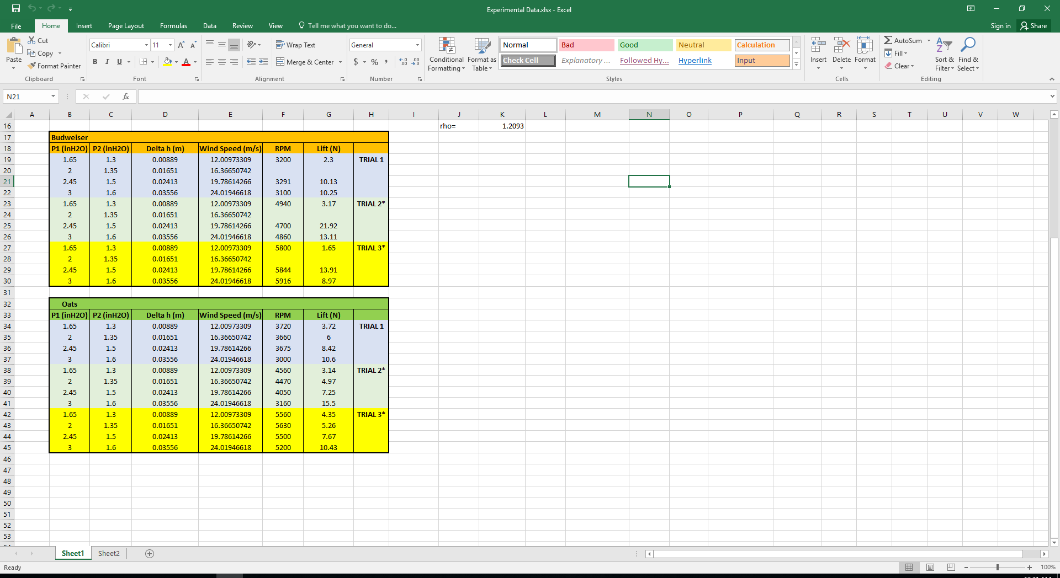
Experiment Data

Slide 11
Results and Discussion
Small Diameter Cylinder (57.91 mm)

Slide 12
Results and Discussion
Medium Diameter Cylinder (83.82 mm)

Slide 13
Results and Discussion
Large Diameter Cylinder (128.27 mm)

Slide 14
Effect of Wind Speed - Confidence Intervals

Slide 15
Summary of observations
Experimental measurements are off from the Magnus equation predictions
Possible causes: high RPM, resonance limitations, force balance inconsistent
Wind Speed negatively affects lift force at smaller diameters, but positively at larger diameters
Larger diameter can better “push” down on the air since at uniform pressure, larger surface area means more force
Largest cylinder diameter: 128.27 mm, medium: 83.82 mm, small: 57.91 mm

Slide 16
Future Work
Additional runs for the medium sized cylinder and more cylinders of different diameters to analyze the effect of changing radius.
Measure the effects of a broader range of RPM by starting at a lower RPM.
Measure the effect of wind speed (into high speed) analysis at more RPMs for different cylinders.

Slide 17
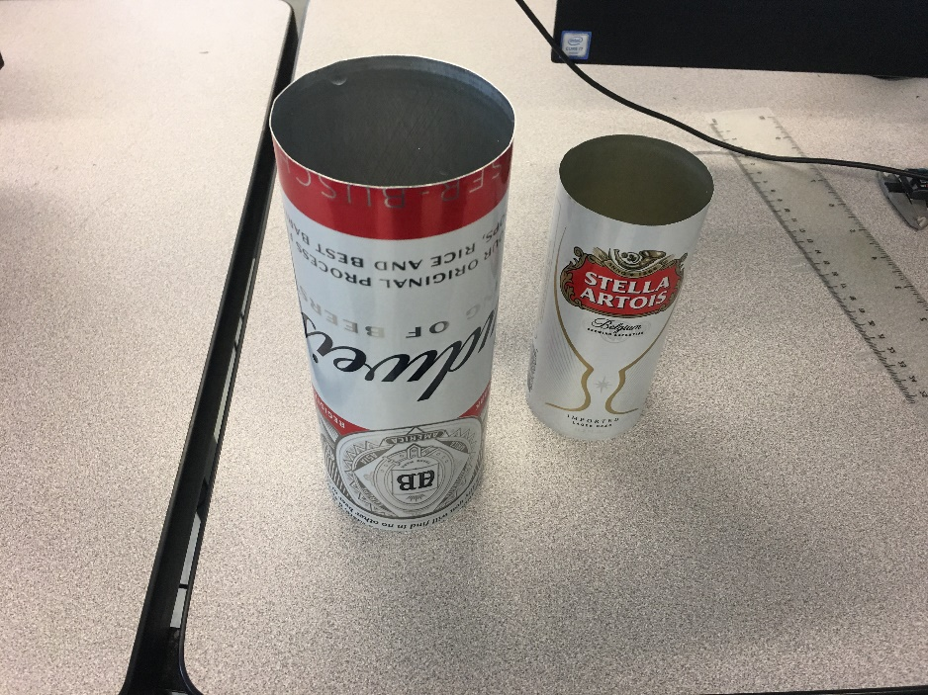
Acknowledgements
Professor Todd Gross, Ivaylo Nedyalkov, and Samuel Cole for their time and effort in making our project possible
No thanks to the troubles caused by the force balance
Finally, a special thanks to Evan Grissino for helping to make it possible to create our airfoils

Slide 18
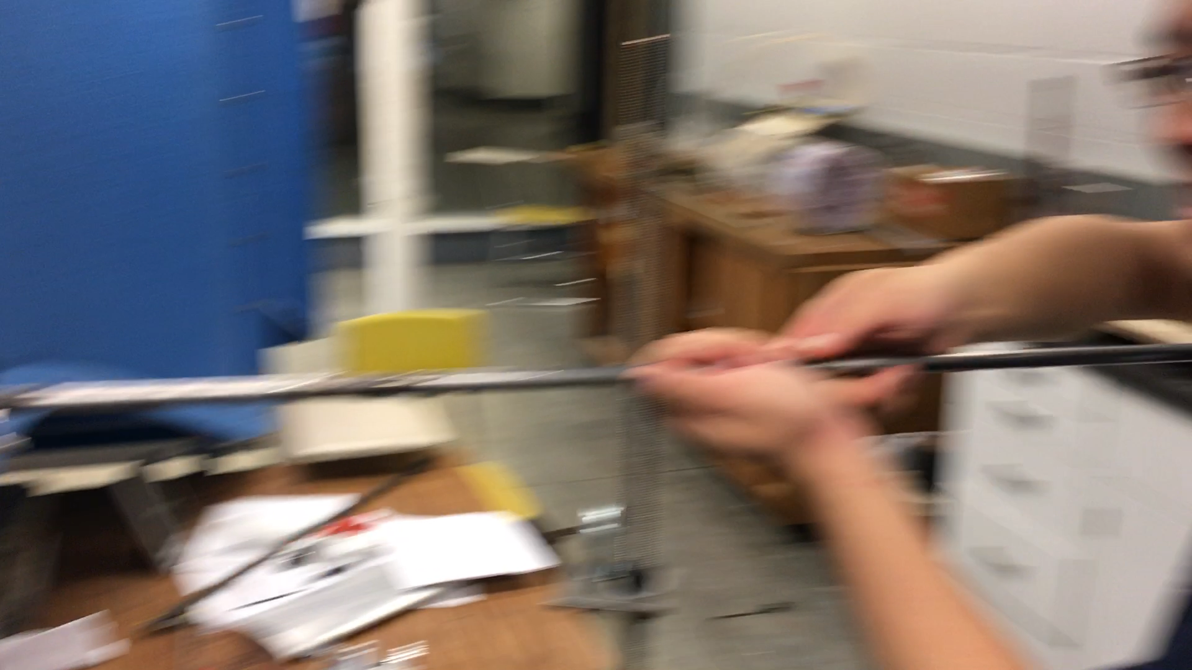
Questions?

